Slide 1
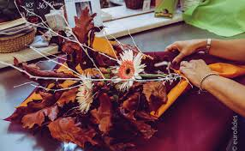
Autumn Bouquets
Image placeholder

Slide 2
Goal
+ 10% sales
Campaign Objective:
Text Increase sales
KPI: increase sales of 10% by the end of Q1

Slide 3
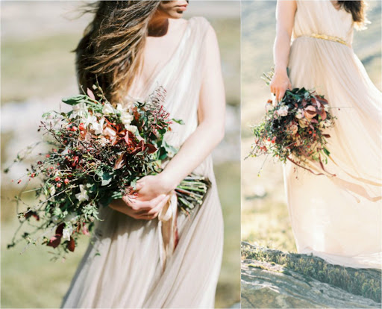
Creative
Assets
Image placeholder

Slide 4
Campaign
Settings
Objective:
Increase 10% Sales
Audience:
Custom Audiences
Looklike Audiences
Placement:
Facebook, Instgram
Duration:
3 months
Budget:
500 $

Slide 5
Results
Campaign Result
500$
Campaign Cost
400 $
ROAS:
Revenue
1000$
Total Investment
Advertising: 300$
Cost: 100$
Total Investment: 400$
ROI:

Slide 6
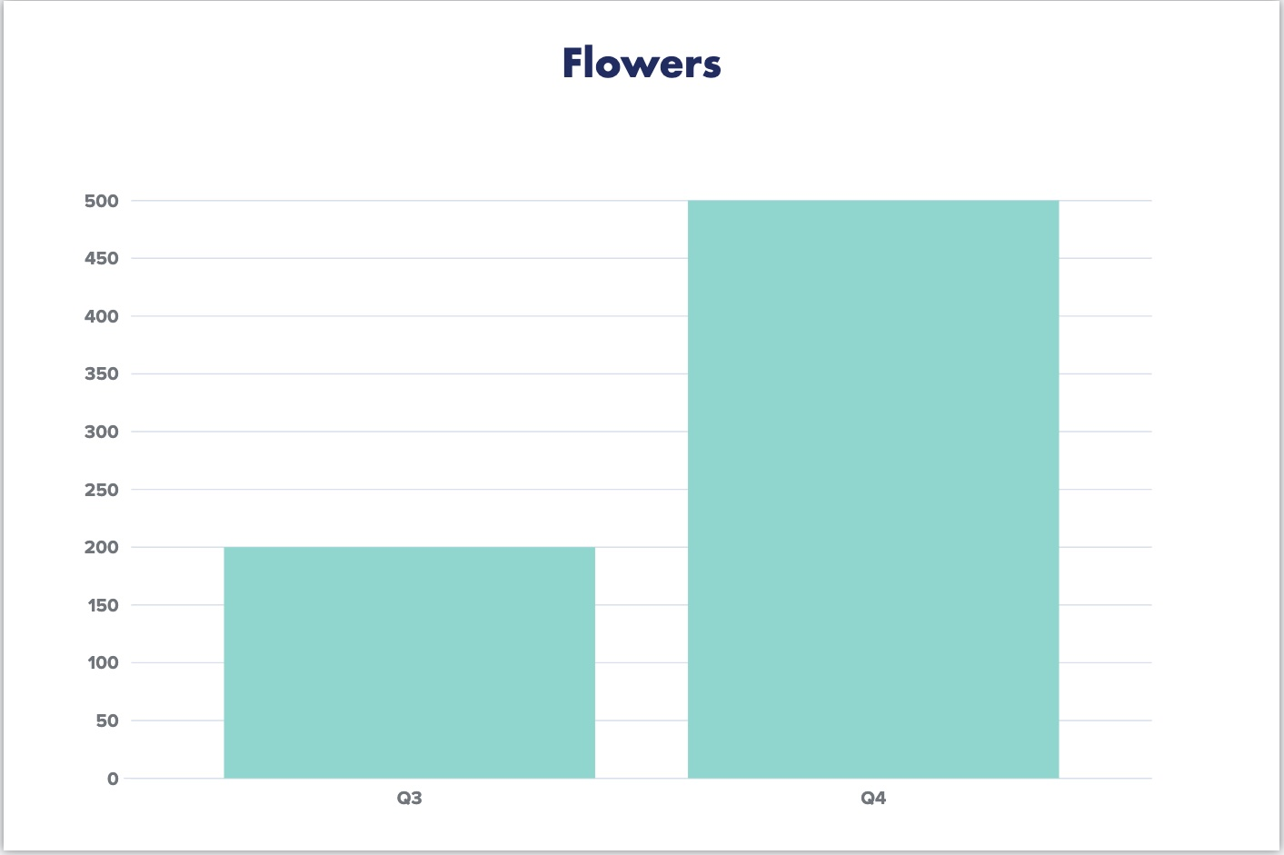
Results
Sales increase in the last Q

Slide 7
Conclusion & Next Steps
The goal is to propose a new promotion in Q2 next year, trying to increase sales even in the targets not yet considered.

Slide 8
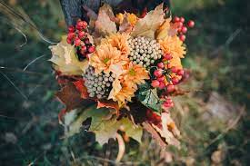
Thank
You!
Image placeholder

