Slide 1
SERVICESCAPE COMPARISON La Montana vs HABIBI
BY
ASMAT ULLAH

Slide 2
Highlights
Introduction
(comparison of servicescape)
Target market
Implication of 4P’s
Tangible Services
Intangible services
Customer Touch points
Recommendations

Slide 3
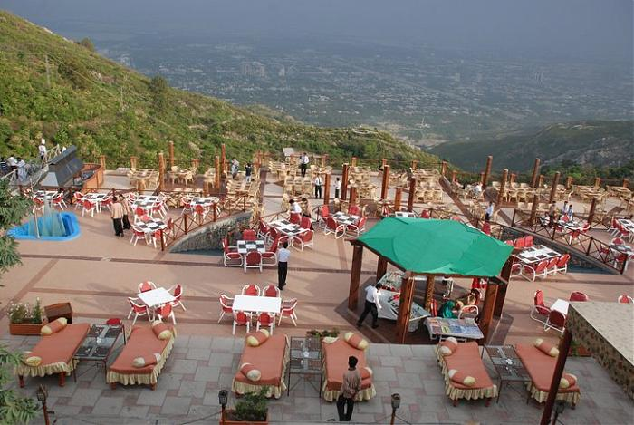
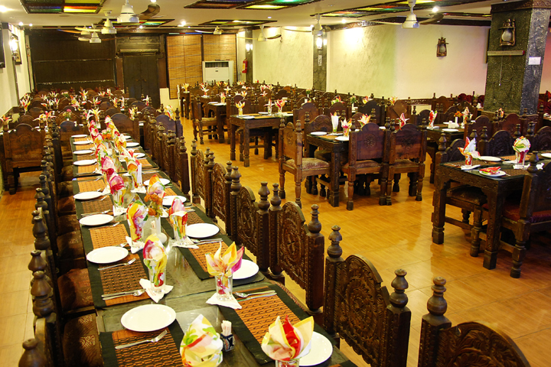
Introduction (La Montana vs HABIBI)

Slide 4
Target market
La Montana
upper class, families, tourists.
Habibi
Families, friends get-together, middle class

Slide 5
4p’S
La Montana
Product; sea food, BBQ, Soup, Burgers, all fast food items, drinks
Habibi
Product; traditional and fast food. rice beef pulau, quail, fish, chicken & beef seekh kabab, chicken tikka, chicken boti and mutton tikka
Place; Margalla Hills,Pir Sohawa Road, Islamabad.
Price; costly compared to habibi, fries:249, pulao:745
Promotion; social media appearance, social events,(picnics, gatherings), other promotional offers
Place; F-8, I-8,PWD, SHARJAH
Price; affortable prices, pulao:170, fries;100
Promotion; broushers, local cable netwerks,occassional packages

Slide 6
tangible services
La Montana
Party events
Habibi
Takes Reservations
Wedding arrangements
open balconies
halls for all activities
Walk-Ins Welcome
Good For Groups
Take Out
Catering
Home delivery
Air Conditioning
valet parking
cool and relaxing climate
implementation of projectors with wifi & sound systems for business meetings in conference sapphire hall.

Slide 7
Intangible services
La Montana
live background music for birthday parties and events.
Habibi
low level of cleanliness
guests are welcomed in professional manner and are guided to their reserved tables.
clean environment
no reservations, no guidance to their tables.
customer feedback and complaints are highly appreciated
no music system
guests are welcomed with traditional way of greetings, (Asslam-o-alakum).
fresh air natural fragrance in outdoor seating.
No outdoor seating.

Slide 8
Customer touch points
La Montana
Treat guests like family, serve great food, and always exceed expectations.
Habibi
Always conveys the message to be honest in delivering the satisfaction to customers in every aspect.
Social media platforms, events, customer feedbacks and complaints.
Promotional offers, ratings, reviews, ads, website.
Most promotion is done through word of mouth.

Slide 9
Recommendations
La Montana
Indicate the energy value of dishes in KJ (e.g. how many calories the individual components of the dish have).
Implement a loyalty program
Implementing a loyalty program, will give customers the opportunity to be rewarded for their patronage to restaurant. By giving customers rewards for their continued support of the business, restaurant will grow the relationships it currently has with them.
Include low-fat dressing and olive oil in your offer.
Habibi
Enable your guests to eat more fresh vegetables. For example, you can leave room for salad on the plate, serve salad first, or put it directly on the plate.
Provide your guests with drinking water.
Offer different side dishes – even with the daily menu.
Use social media effectively to create brand awareness and stay connected with customers
Bring in live entertainment to create an ambiance for the restaurant

Slide 10
Thank you

