Slide 1
Chapter 1
Process models of change

Slide 2
Process models of change
This tutorial examines change from a process perspective.
A
B
C
D
Understanding change as a process can help those leading change step back and observe what is going on and explore alternative ways of acting that might deliver superior outcomes.

Slide 3
States and processes
The states perspective focuses attention on the “what” of change - what it is that needs to be, is being or has been changed.
Current
state
Future
state

Slide 4
States and processes
The process perspective attends to the “how” of change and focuses on the way a transformation occurs.
It draws attention to issues such as:
  the pace of change and the sequence of activities
  the way decisions are made and communicated
  the ways in which people respond to the actions of others.
Current
state
The change process
Future
state
A
B
C
Change managers play a key role in this transformation process.

Slide 5
The change process
Teleological theories
Dialectical theories
Life cycle theories
Evolutionary theories
A common feature of all four theories is that they view change as involving a number of events, decisions and actions that are connected in a sequence…
... but they differ in terms of the degree to which they present change as:
following a necessary sequence of stages, and
the extent to which the direction of change is constructed or predetermined.

Slide 6

The order of stages
Some theories place more emphasis on the order of the stages in the change process than others.
Life cycle theories are more prescriptive about this than teleological theories.
  6. Integration
5. Diversification
7. Decline
(or revitalization)
4. Consolidation
3. Professionalization
2. Expansion.
© Thinkstock
The seven stages of Flamholtz’s organisational life cycle
  1. New venture

Slide 7
The order of stages
Teleological theories are less prescriptive about the ordering of stages.
Diagnose
Formulate
goal
Implement
Evaluate
Learn
While each of these stages is important and there is a logical sequence connecting them, the sequence does not have to, and often does not, unfold in a way that follows this ordered linear sequence.
The car importer example illustrates this point.

Slide 8

The car importer example
The manufacturer of an inexpensive range of cars informed an importer that it had decided to reposition its brand.
The importer quickly recognised that this would require a lot of changes to its own business.
©DIGITALVISION
An initial diagnosis indicated that the importer would have to encourage many of these dealers to refurbish and modernise their premises, and in some cases relocate in order to attract the type of customer who would be interested in more expensive and better quality cars.

Slide 9

The car importer example
The importer quickly began to formulate a change strategy, but initial approaches to a sample of dealers to test out plans for change met with strong resistance.
©Brand X pictures
Diagnose
Formulate
goal
Implement
Evaluate
Learn
= critical junctures
This triggered a rethink.

Slide 10
The car importer example
The problem was reframed and a second diagnostic exercise was undertaken to provide the basis for a new strategy.
Diagnose
Formulate
goal
Implement
Evaluate
Learn
Diagnose
Formulate
goal
Implement
Evaluate
Learn
When this strategy was tested another set of problems were identified, and this prompted a third rethink.

Slide 11
The car importer example
The third way forward was a two prong strategy that involved:
working with some of the existing dealers to help them make the changes necessary to move up-market and sell the rebranded cars,
establishing a new business to import and distribute the cheaper Indian produced vehicles.
Diagnose
Formulate
goal
Implement
Evaluate
Learn
Diagnose
Formulate
goal
Implement
Evaluate
Learn
Formulate new goal
Implement
Evaluate
Learn

Slide 12
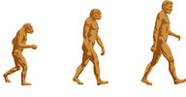
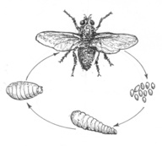
Direction of change: Predetermined trajectories
Life cycle and evolutionary theories present change as a prescribed process that unfolds over time in a pre-specified direction.
  Integration
Diversification
Decline
(or revitalization)
Consolidation
© Macmillan Australia/Primary Library/Richard Morden
Professionalization
Expansion
  New venture
The process is constrained by some immanent (inherent) code or by factors external to the immediate system.
© Macmillan South Africa

Slide 13
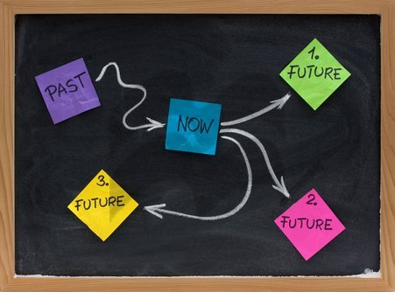
Direction of change: Constructed trajectories
Teleological and dialectical theories view change trajectories as constructed in the sense that goals, and the steps taken to achieve goals, can be changed at the will of (at least some of) those involved in the process.
© Thinkstock

Slide 14
Summary
While all process theories present change as involving a series of events, decisions and actions, they differ in terms of the degree to which:
these events, decisions and actions follow a prescribed pattern
the direction of change (the change trajectory) is predetermined or can be influenced by those involved in the process.

