Slide 1
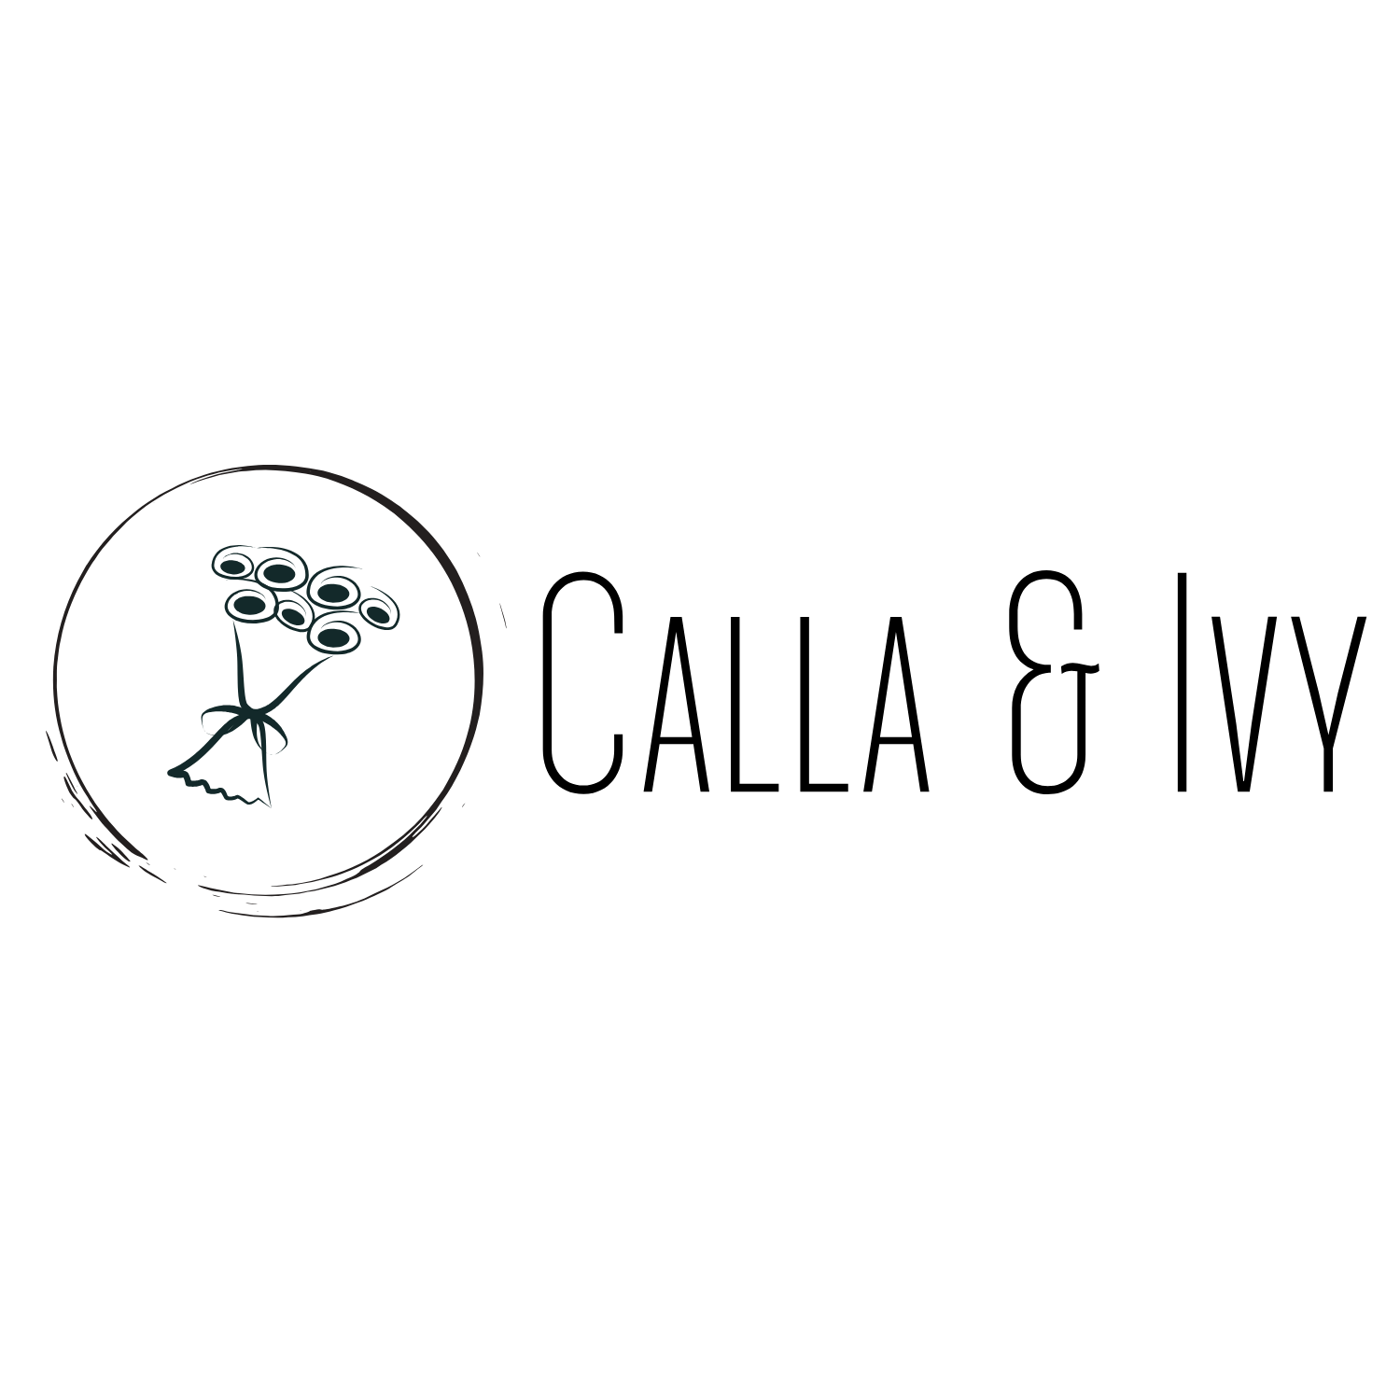
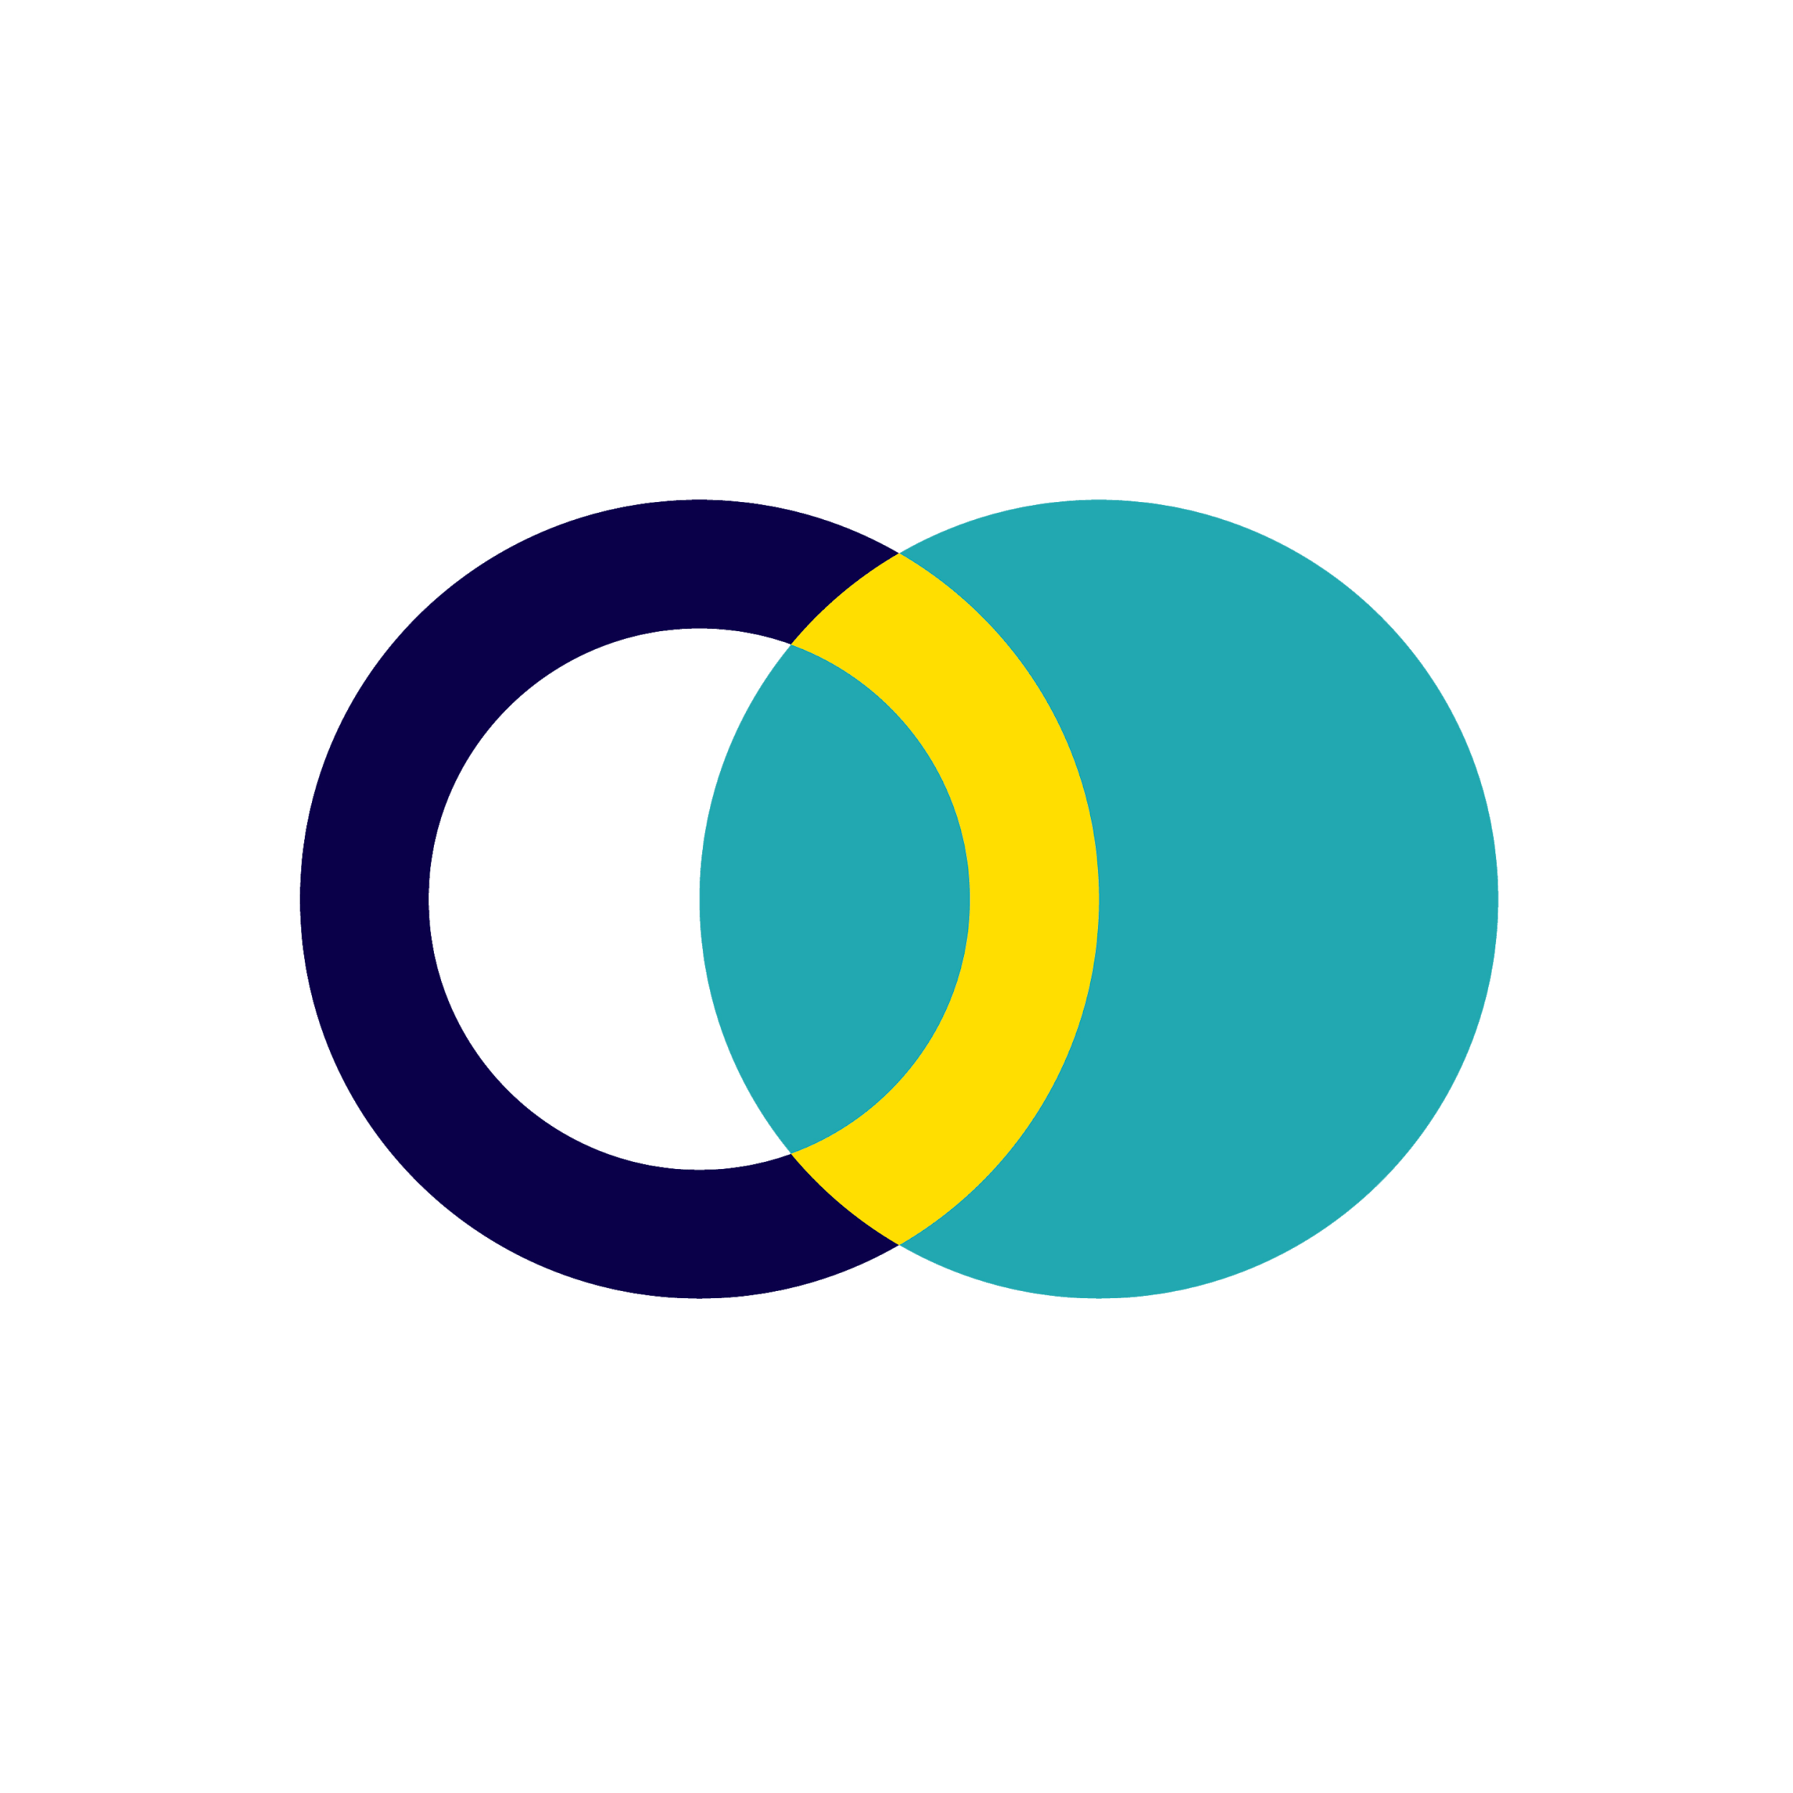
Campaign Results

Slide 2
Goal
10% increase of online sales by the end of 1st quarter.
Campaign Objective:
Consideration/Traffic -Link clicks, landing page views.
KPI:
Likes, comments and shares, tracked through Facebook, Instagram and audience network.

Slide 3
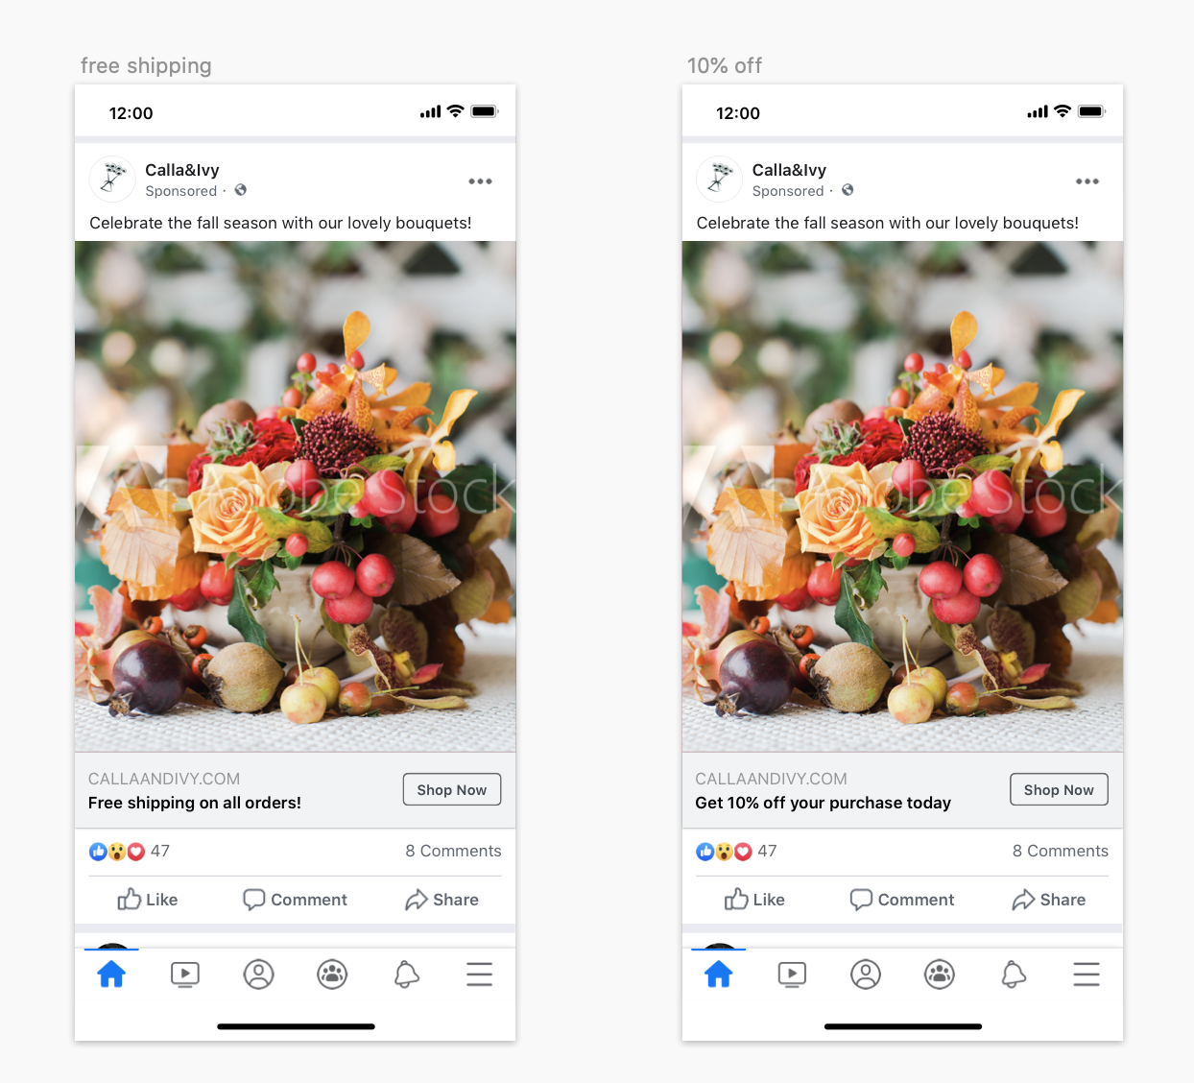
Creative
Assets

Slide 4
Campaign
Settings
Objective:
Traffic
Audience:
24 - 55
Women, interested in cut flowers
Northern Holland Region
Placement:
Facebook, Instagram, Audience network.
Duration:
End of first quarter.
Budget:
$100 per day

Slide 5
Results
Campaign Result
40, 395 link clicks
Reach: 103.6K
$40/subscriber
Campaign Cost
$2824.50
ROAS: 15.97
Revenue
$45,120
Total Investment
Advertising: $3000
Cost: $2824.50
Total Investment: $5824.50
ROI: 6.75

Slide 6
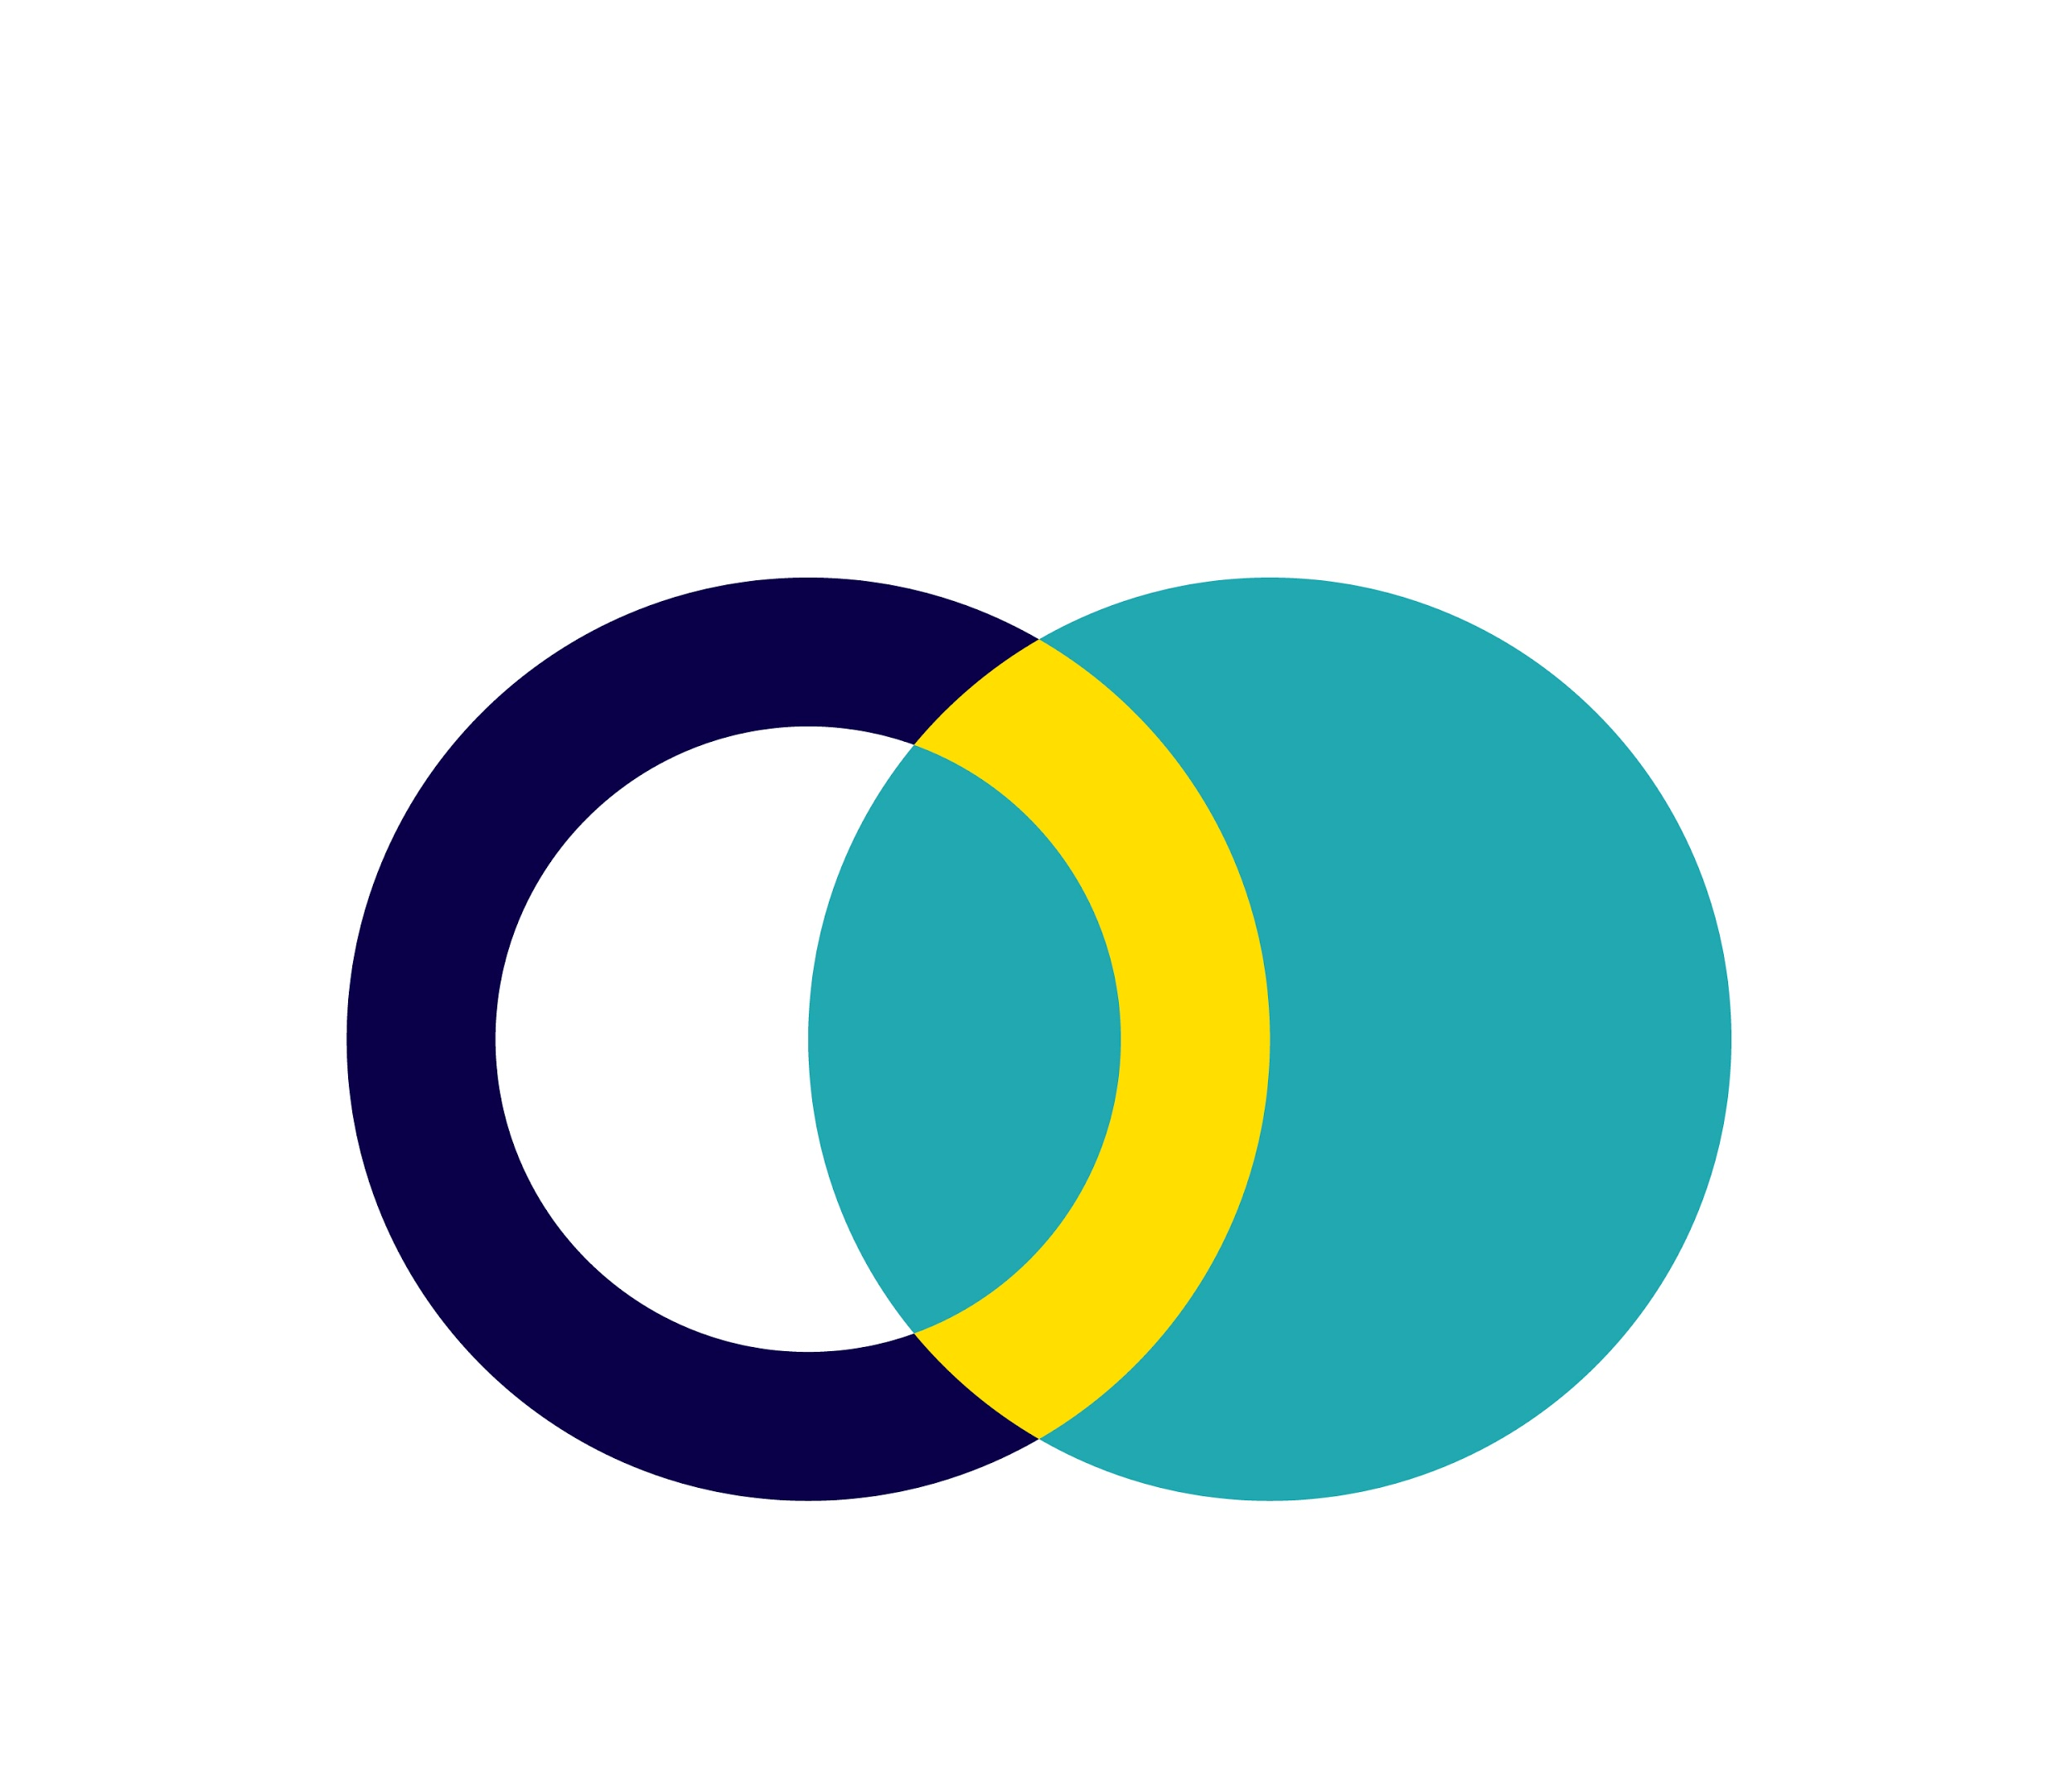
Results
Winning Ad
95% confidence

Slide 7
Conclusion & Next Steps
Cost of purchase equals $15 per
Try using a new photo with same ad
Continue to focus on women, the age of 24-55
Continue to use ads with free shipping
Keep optimizing to reduce conversion costs

Slide 8
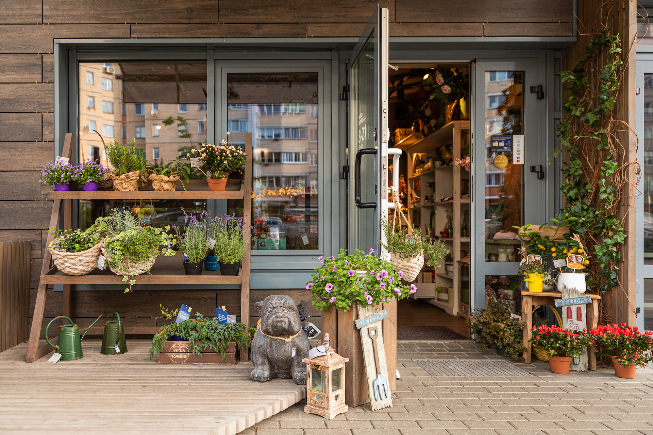
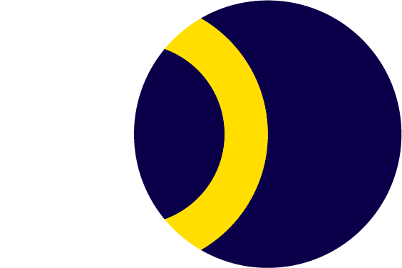
Thank
You!

