Slide 1
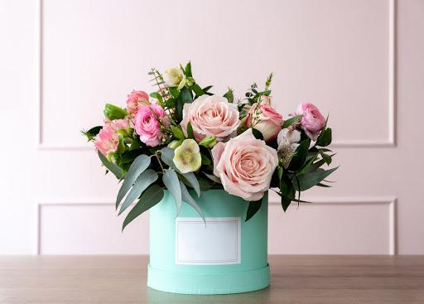
Consideration Campaign
Image placeholder

Slide 2
Goal
Increase website traffic by 40,000 in 6 weeks
Campaign Objective:
Consideration
KPI:
Links clicks & landing page views

Slide 3
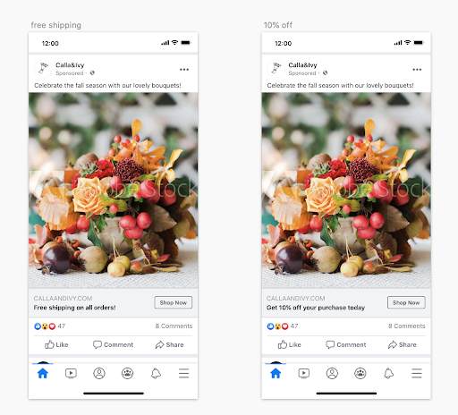
Creative
Assets
Image placeholder

Slide 4
Campaign
Settings
Objective:
Increase website traffic
Audience:
Women
Age 25-55
Northern Holland
Placement:
Lookalike audience to best customers
Duration:
Nov. 6, 2020- Dec. 15, 2020
Budget:
$50 daily, with lifetime budget $2824.50

Slide 5
Results
Campaign Result
40,350 Link Clicks
2,224,012 Reach
Campaign Cost
$2824.50
ROAS:
Revenue
40,350 clicks x 2% (conversion rate)= 807 purchases
807 purchases x $40 avg purchase = $32,280 revenue
.92
Total Investment
Advertising: $2824.50
Cost: $12,105
Total Investment: $14,929.50
ROI:

Slide 6
A/B Test
Create an A/B test to measure effectiveness of Headline promotion
Image placeholder
Image placeholder

Slide 7
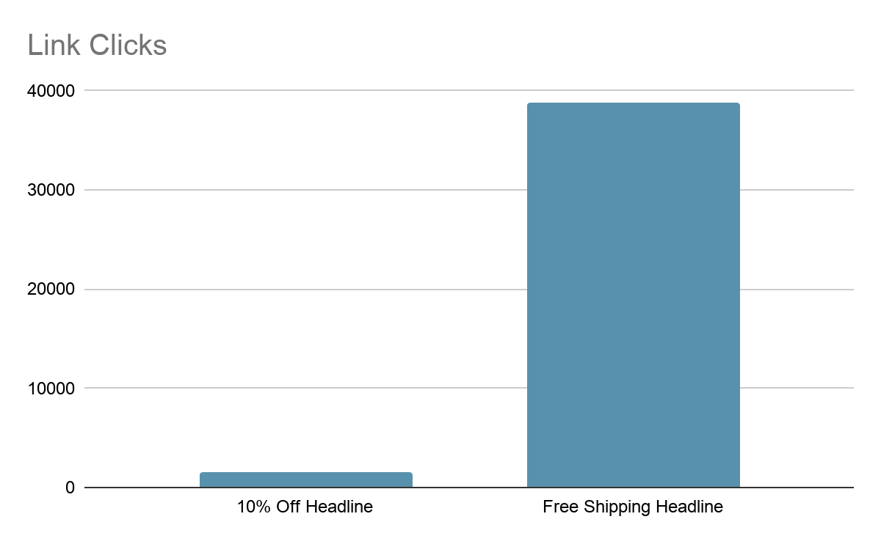
A/B Test Results

Slide 8
Conclusion & Next Steps
Campaign achieved goal of obtaining 40,000 website visitors
As determined through A/B testing Free Shipping ad performed better than 10% prompt with a 95% confidence rate
For future campaigns, look to improve ROI by reducing costs

Slide 9
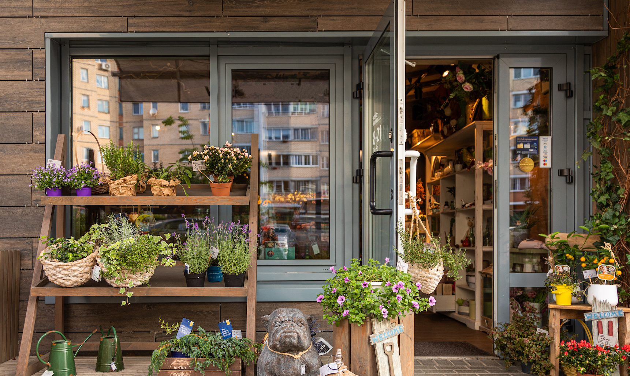
Thank
You!
Image placeholder

