Slide 1
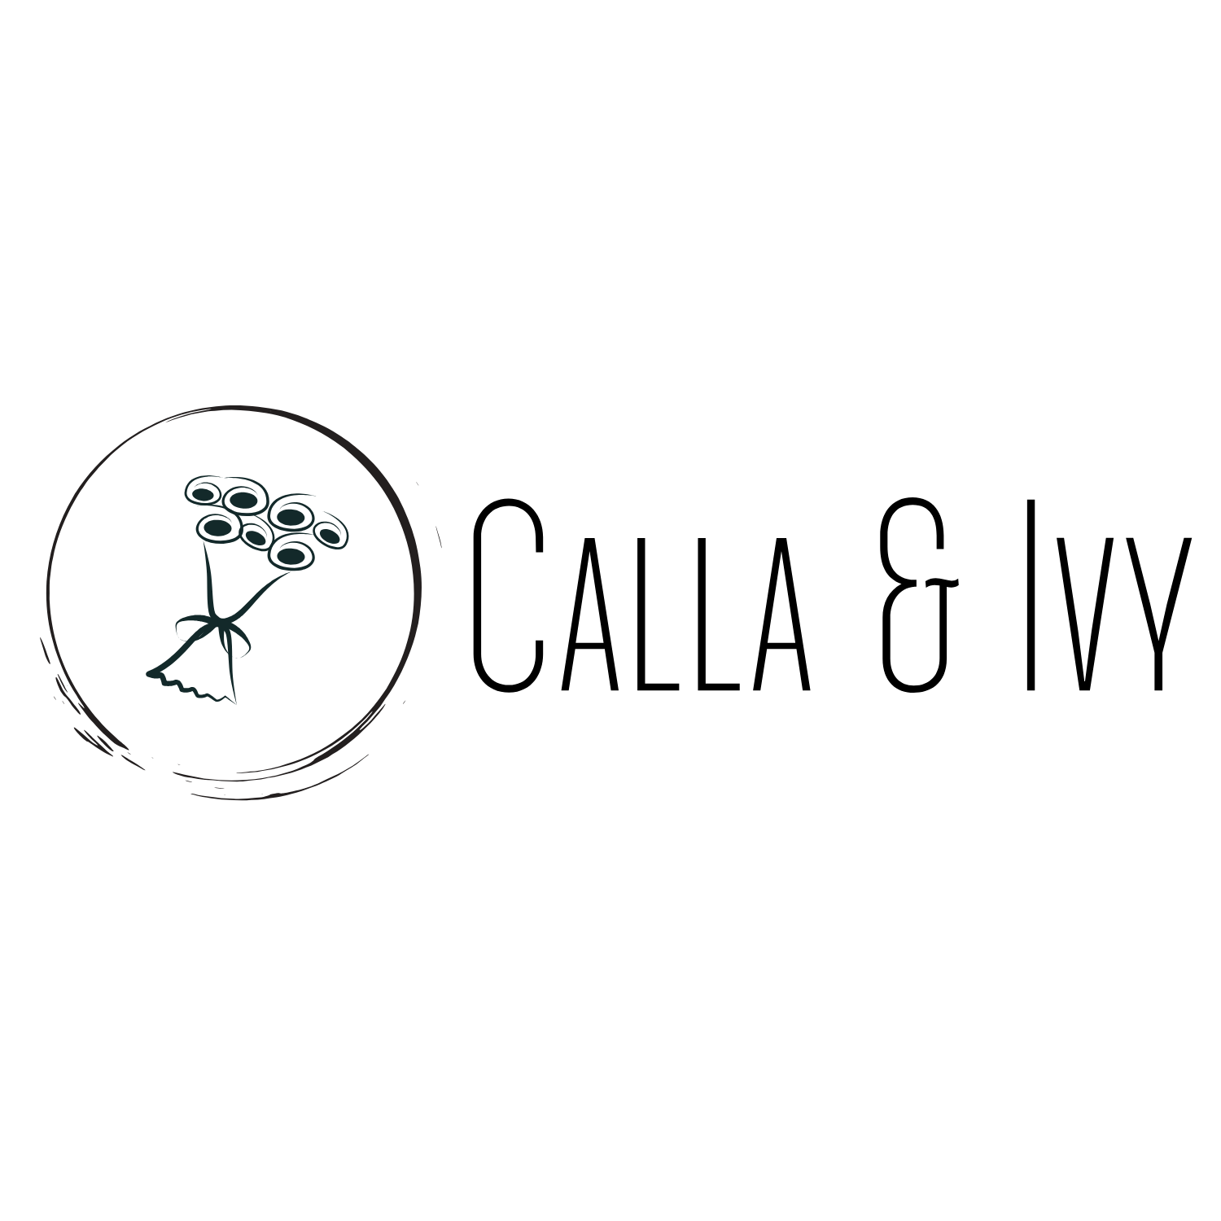
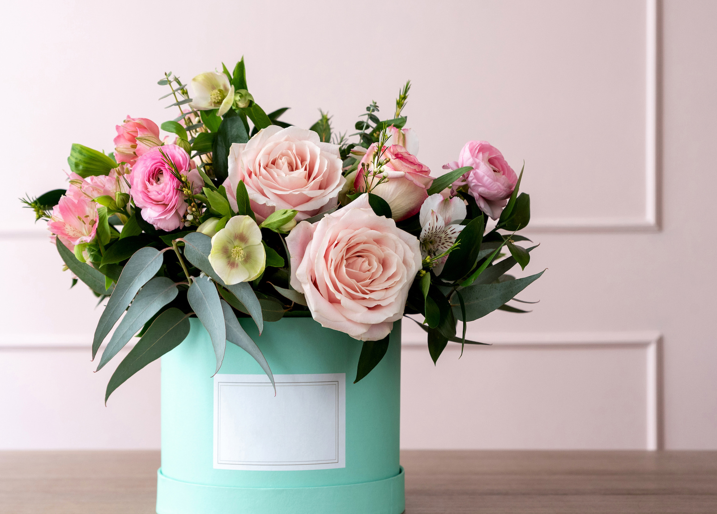
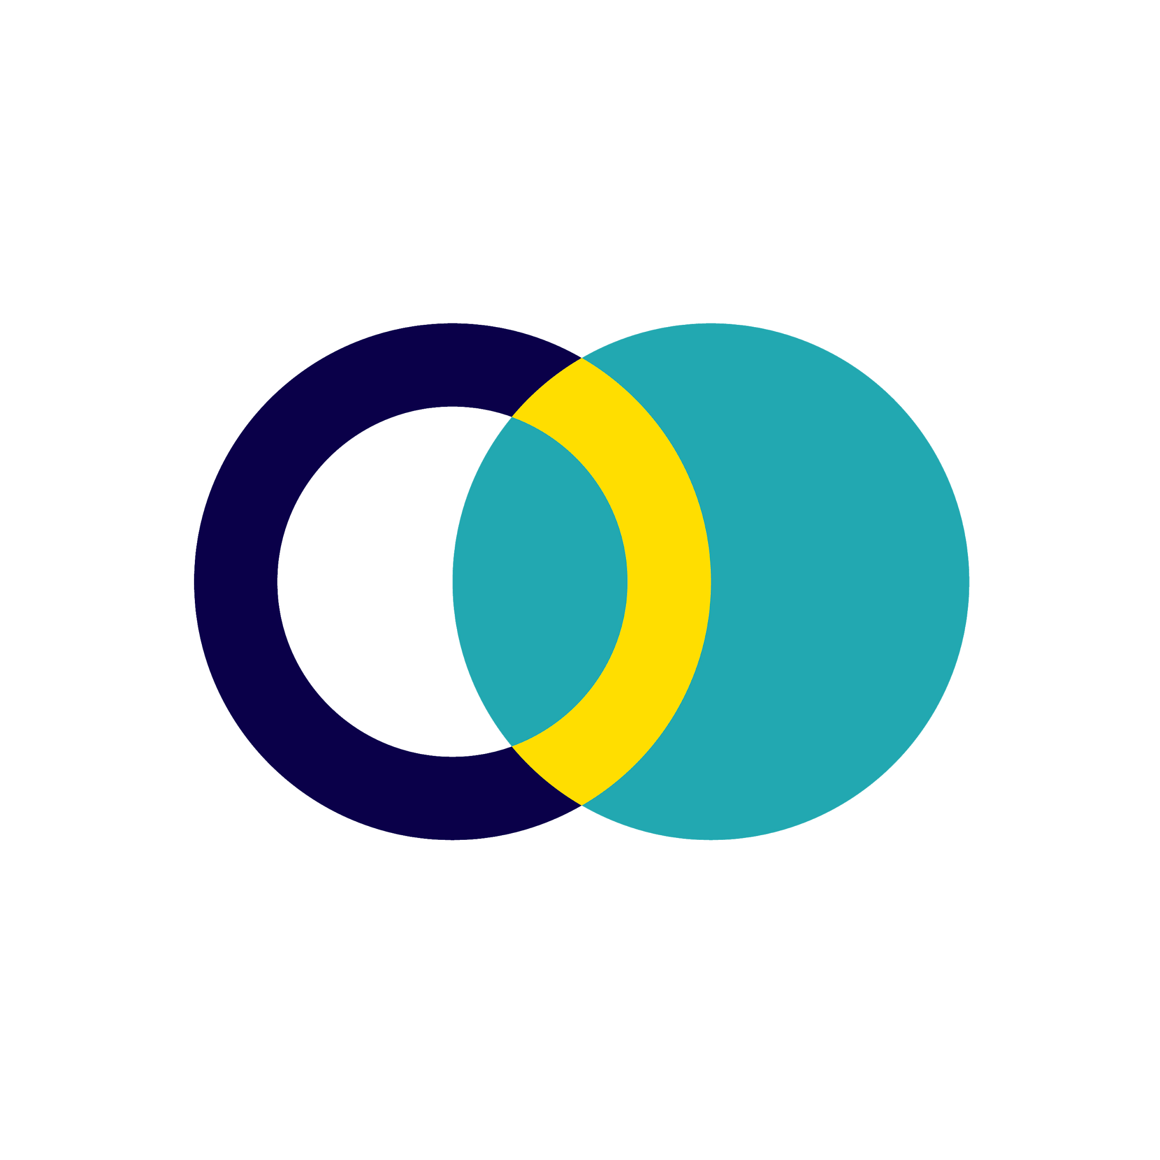
Results Presentation
Image placeholder

Slide 2
Goal
Increase sales by 10% by the end of Q1
Campaign Objective:
Traffic
KPI:
Link clicks

Slide 3
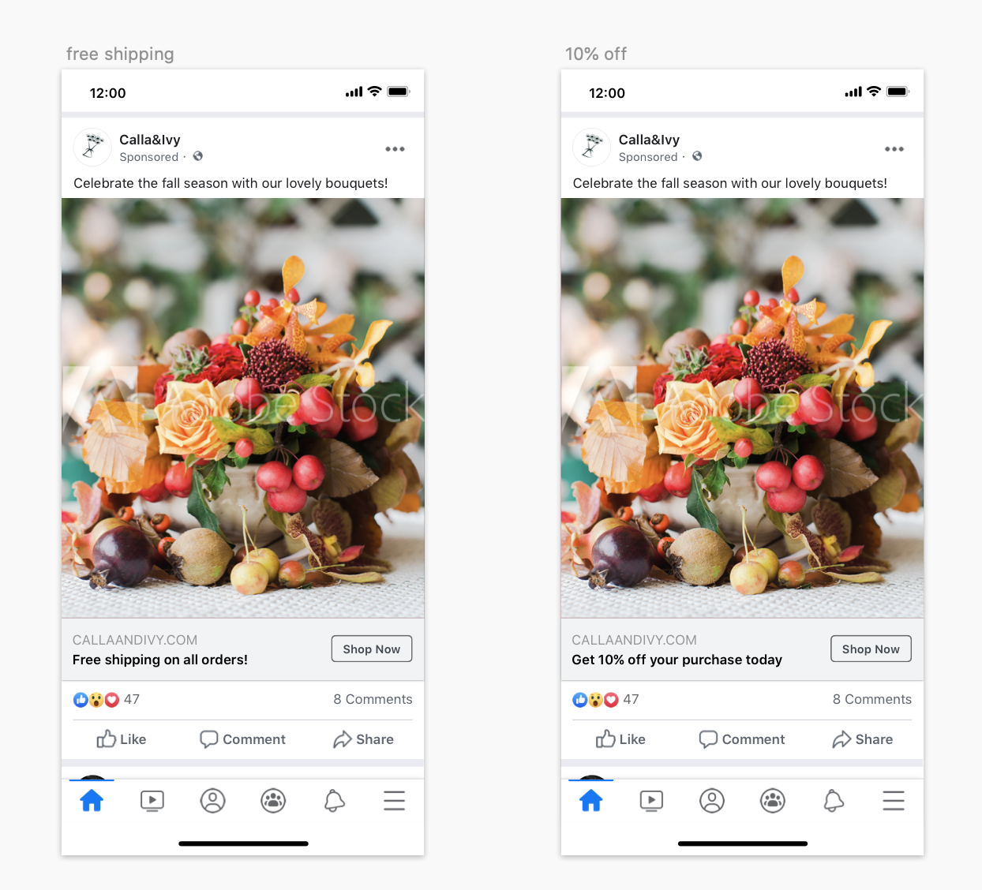
Creative
Assets
Image placeholder

Slide 4
Campaign
Settings
Objective:
Traffic
Audience:
Women
24-55 years old
Interests: cut flowers
Located in Northern Holland
Placement:
Facebook, Instagram, and Audience Network
Duration:
40 days (Nov 6, 2020 - Dec 15, 2020)
Budget:
$50/day ($2,000 total)

Slide 5
Results
Campaign Result
40,350 link clicks
1,570 clicks - 10% off ad
38,780 clicks - free shipping ad
Campaign Cost
Budget = $2,000
Ad Spend = $2,824.50
ROAS: 10.96
Revenue
2% of visits resulted in a purchase = 775 purchases
$40 = average purchase value
Total Investment
Advertising: $2,824.50
Cost: $15 per arrangement
Total Investment: $14,449.50
ROI: 1.15

Slide 6
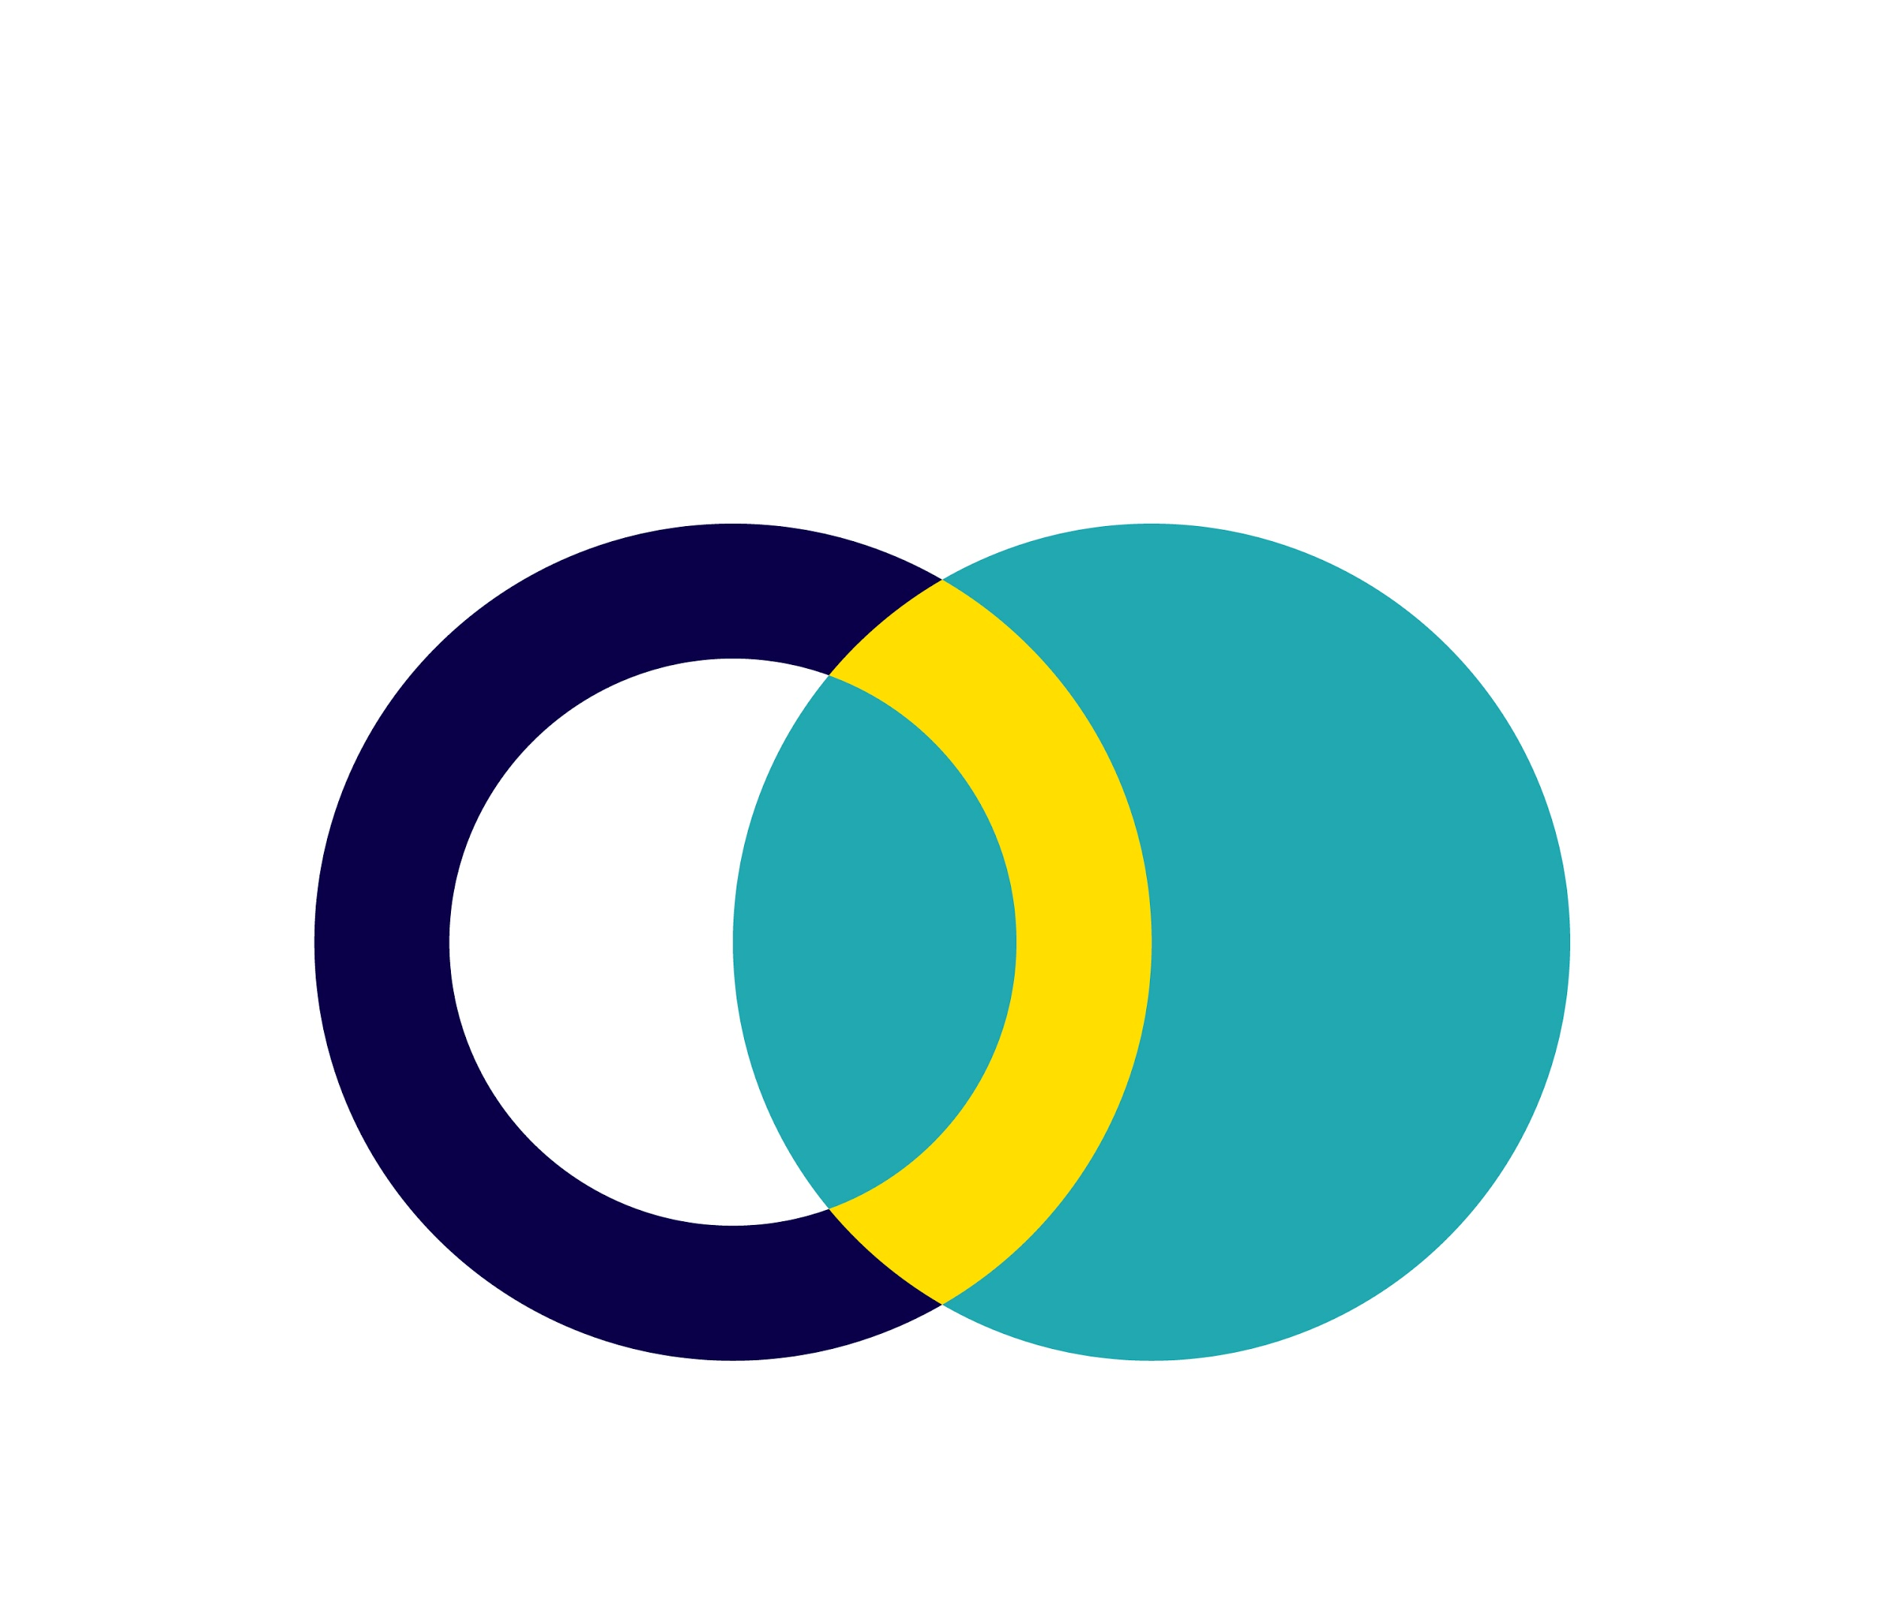
Results
Version B
38,780 clicks
Version A
1,570 clicks
Free Shipping was a better offer than a 10% discount
Cost per Result
A = $0.48/link click
B = $0.05/link click
Image placeholder
Image placeholder

Slide 7
Conclusion & Next Steps
Expand ads to Messenger to further optimize
Use Free Shipping as the CTA
Keep A/B testing to optimize creative
Target other interests
Target locations outside of North Holland

Slide 8
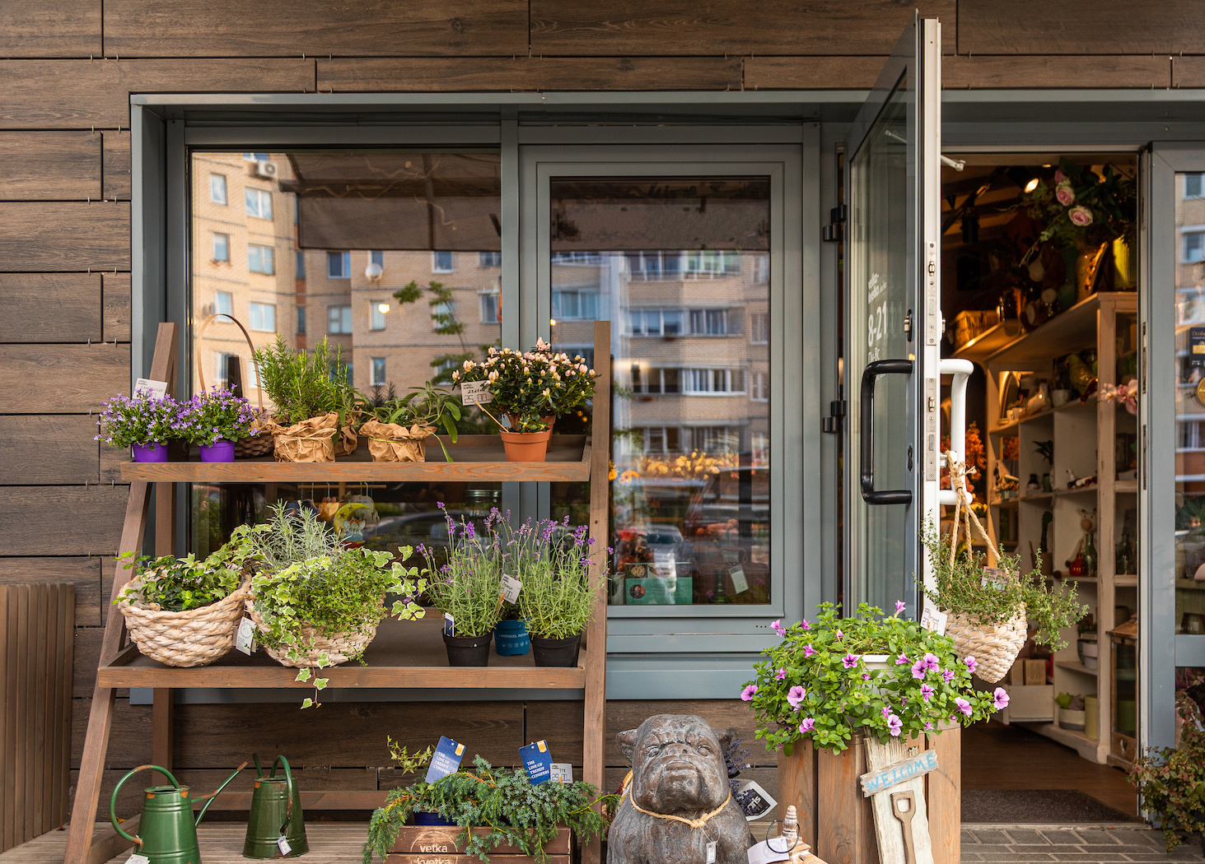
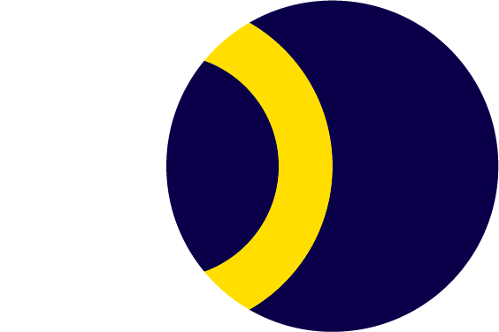
Thank
You!
Image placeholder

