Slide 1

Pitch deck
Mirjam Nilsson​​

Slide 2

About us
At Contoso, we empower farming communities to foster collaborative thinking to further drive workplace innovation. By closing the loop and leveraging ethical farming methods, we help businesses grow organically and nurture a consumer first mindset.

Slide 3
problem
Market gap
Customers
Organic agriculture continues to be consumer driven, but we're seeing a lapse of availability in the market for organic products
6.6% increase of retail sales of organic food proves that there's consumer interest for more organic produce
Costs
Usability
Loss of sales by not offering organic produce selection
Retail organic food sales were up by $112 billion in 2019
Financials
Customers want something that's healthy and available to pick up at their local supermarket or area

Slide 4
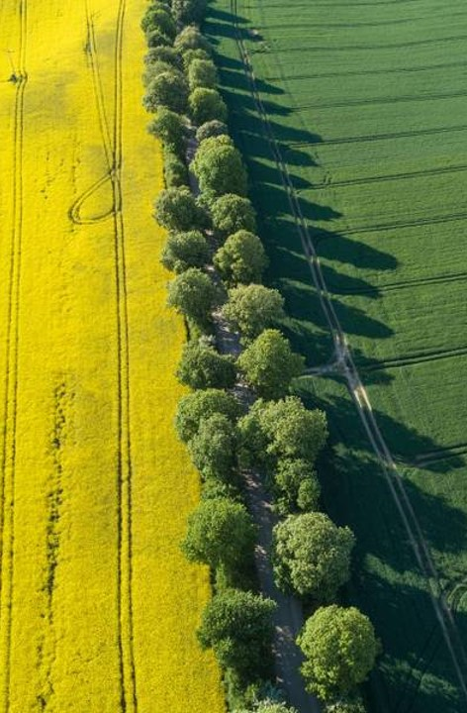
solution
Close the gap
Target audience
Our product makes organic farming easier, and no other product on the market offers the same benefits or yield.
Gen Z (18-25 years old)
Cost savings
Easy to use
Reduce expenses for replacement products
A simple product that gives customers the information they need in order to produce an abundance of rich produce

Slide 5




Product overview
Unique
First to market
Tested
Authentic
Only product specifically dedicated to the agricultural market
First beautifully designed product that's both stylish and functional
Conducted testing with young farmers in the area
Designed with the help and input of agricultural experts in the field

Slide 6

Product Benefits
Cool and stylish product​
Areas for community connections ​
Online store and market swap

Slide 7
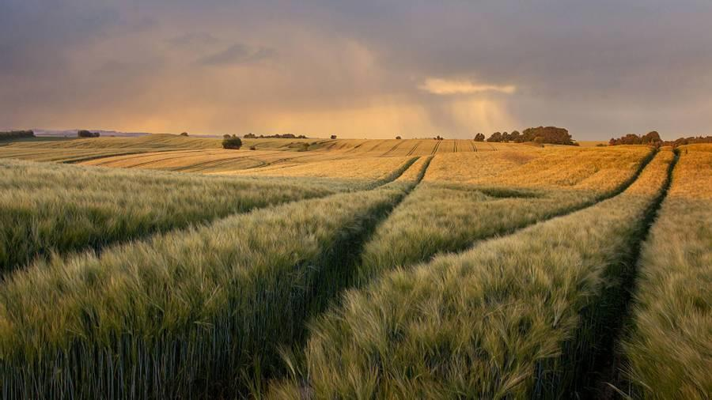
Company Overview

Slide 8

Why Motivation
Why Motivation Theories
Although there is so much research, theory, and data on motivation, why do we need additional qualitative research on motivation theories?
Is it because of evolving society, culture, laws, & technology that people's preferences, thinking/behaving patterns are changing so do their motivational factors/triggers are constantly developing thet's why motivation theories and research is needed?

Slide 9
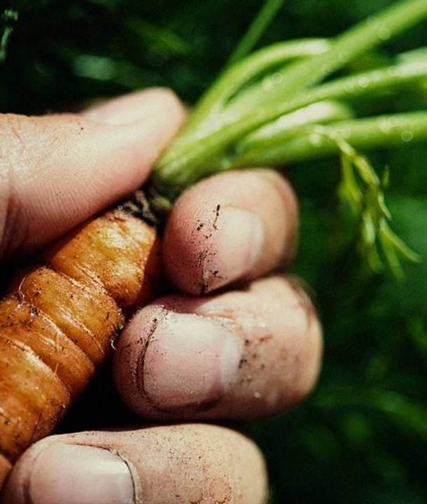
Market overview
Opportunity to build​
Fully inclusive market
Total addressable market​
$3B​
Freedom to invent​
Selectively inclusive market​
Serviceable available market​
$2B
Few competitors​
Specifically targeted market​
Serviceable obtainable market​
$1B

Slide 10

Market comparison
$3b
$2b
$1B
Opportunity to build
Freedom to invent
Few competitors
Addressable market​
Serviceable market​
Obtainable market​

Slide 11
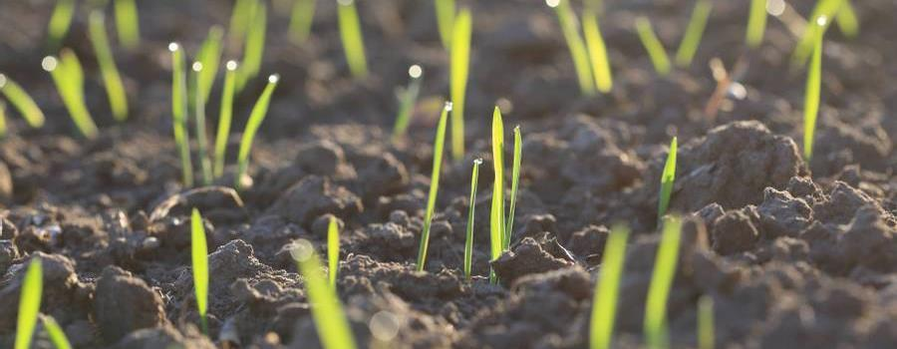
Our competition
contoso
Competitors
Our product is priced below that of other companies on the market​
Design is simple and easy to use, compared to the complex designs of the competitors​
Affordability is the main draw for our consumers to our product​
Company A​
Product is more expensive​
Companies B & C ​
Product is expensive and inconvenient to use​
Companies D & E​
Product is affordable, but inconvenient to use

Slide 12
Competitive layout
convenient
contoso
A
Expensive​
affordable
B
D
C
E
Inconvenient​

Slide 13

Growth strategy
How we’ll scale in the future​
Feb 20xx
Roll out product to local farms in the region to help establish the product​
May 20xx
Release the product to the general public and monitor press and regional market trends​
Oct 20xx
Gather feedback from the agriculture and farming community to expand availability of the product​

Slide 14
Traction
Forecasting for success​
Metrics
Revenue by year
 | clients | orders | Gross avenue | Net revenue
20XX​ | 10​ | 1,100​ | $10,000​ | $7,000​
20XX​ | 20​ | 200​ | $20,000​ | $16,000​
20XX​ | 30​ | 300​ | $30,000​ | $25,000​
20XX​ | 40​ | 400​ | $40,000​ | $30,000​

Slide 15
2-year action plan
Get volunteers​
Gather feedback​
Deliver to consumers​
20XX
Jan
Feb
Mar
Apr
May
Jun
Jul
Aug
Sep
Oct
Nov
Dec
Run focus groups​
Test with farms​
Regional launch​
20XX
Jan
Feb
Mar
Apr
May
Jun
Jul
Aug
Sep
Oct
Nov
Dec

Slide 16
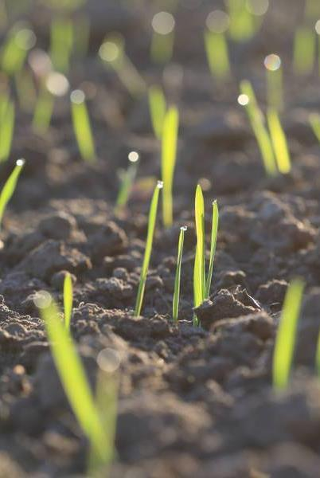
financials
 | Year 1 | Year 2 | year 3
Detailers​ | 5,000​ | 40,000​ | 160,000​ | ​
Users​ | 50,000​ | 400,000​ | 1,600,000​ | ​
Sales​ | 500,000​ | 4,000,000​ | 16,000,000​ | ​
Average Price per Sale​ | 75​ | 80​ | 90​ | ​
Revenue @ 15%​ | 5,625,000​ | 48,000,000​ | 216,000,000​ | ​
Gross Profit​ | 5,625,000​ | 48,000,000​ | 216,000,000​ | ​
Expenses​ | ​ | ​ | ​ | ​
Sales & Marketing​ | 5,062,500​ | 38,400,000​ | 151,200,000​ | ​
Customer Service​ | 1,687,500​ | 9,600,000​ | 21,600,000​ | 70%​
Product Development​ | 562,500​ | 2,400,000​ | 10,800,000​ | 10%​
Research​ | 281,250​ | 2,400,000​ | 4,320,000​ | 5%​
Total Expenses​ | 7,593,750​ | 52,800,000​ | 187,920,000​ | 2%​
EBIT | -1,968,750 | -4,800,000 | 28,080,000 | ​

Slide 17


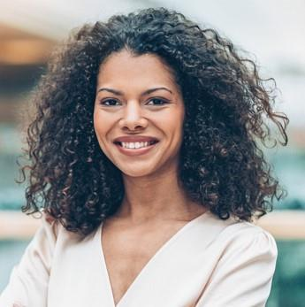

Meet the team
Takuma Hayashi​​
Mirjam Nilsson​​
Flora Berggren​​
Rajesh Santoshi​​
President
Chief Executive Officer​
Chief Operations Officer​
VP Marketing​

Slide 18








Meet the team
Takuma Hayashi​
Mirjam Nilsson​
Flora Berggren​
Rajesh Santoshi​
President
Chief Executive Officer
Chief Operations Officer
VP Marketing
Graham Barnes
Rowan Murphy
Elizabeth Moore
Robin Kline
VP Product
SEO Strategist
Product Designer
Content Developer

Slide 19
Funding
12K
32K
14K
82K
Campaigns​
Angel investments​
Cash
Shares
Revenue obtained from online campaigns and door-to-door sales​
Amount obtained through other investors
Liquid cash we
have on hand
Number of shares converted into USD

Slide 20

summary
At Contoso, we believe in giving 110%. By using ethical farming methods, we help farming communities grow organically and foster a consumer first mindset. We thrive because of our market knowledge and a great team behind our product. As our CEO says, "Efficiencies will come from proactively transforming how we do business."

Slide 21
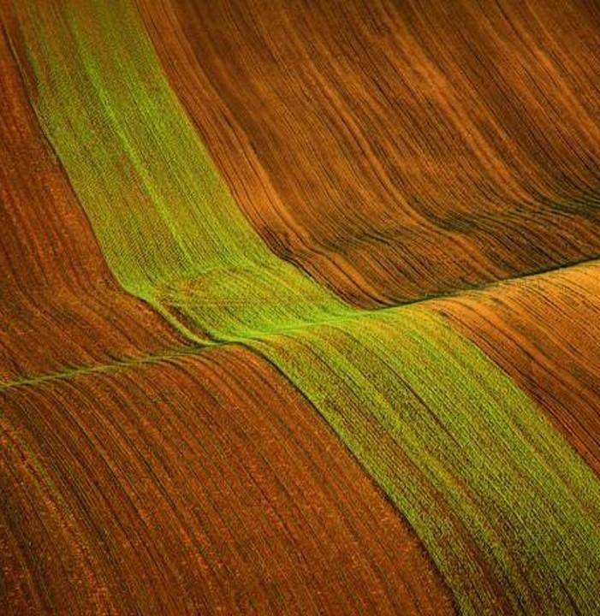
Thank you
Mirjam Nilsson​​
206-555-0146​
mirjam@contoso.com​
www.contoso.com​

